Slide 1

Enhancing Search Engine
Relevance for Video Subtitles
Submitted By:
Team ID: T211040
Sai Nikhil Sadhula – IN1240484
Snehal Vispute - IN1241043

Slide 2
Contents
Objective
Introduction
Types Of Search Engine
Project Workflow
Data Extraction
Data Sampling
Data Preprocessing
Chunking
Text Vectorization
Storing Embedding In Chroma dB
Semantic Search
Conclusion

Slide 3

Objective
This project aims to develop an advanced search engine algorithm that can efficiently retrieve relevant subtitles based on user queries.
To utilize natural language processing (NLP) and machine learning (ML) techniques, the algorithm will enhance the accuracy and relevance of the search results.

Slide 4
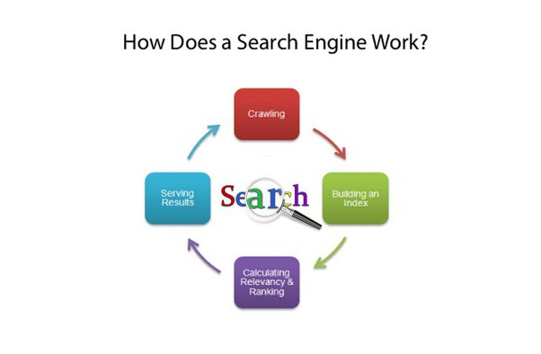
Introduction
Search engines are like digital maps in the online world. They're super smart programs that sift through the massive amount of information on the internet to find exactly what you're looking for – whether it's a recipe, a tutorial, or the latest news.
Over time, search engines have gotten really good at understanding what we want. From the early days of just matching keywords to now, where they can understand full sentences and even guess what we might be interested in next.

Slide 5
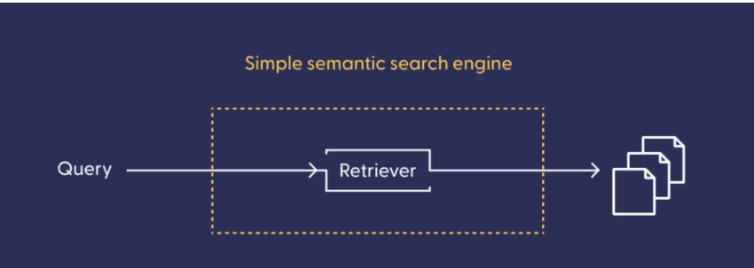
Types of Search Engines
Keyword-based Search Engine: This type matches the exact words in the search query. It's simple but might not understand words that mean the same thing or are phrased differently.
Semantic-based Search Engine: This one understands what you mean when you search, even if you say it differently. It's smarter and gives better results than keyword-based ones.
While keyword-based search engines focus primarily on matching exact keywords in documents, semantic-based search engines aim to understand the deeper meaning and context of user queries to deliver more relevant and meaningful search results.

Slide 6
Project Workflow
Data Extraction
Data Sampling
Data preprocessing
Document Chunking
Text Vectorization (Embeddings)
Storing Embeddings in ChromaDB
User Query
Semantic Search
Results

Slide 7
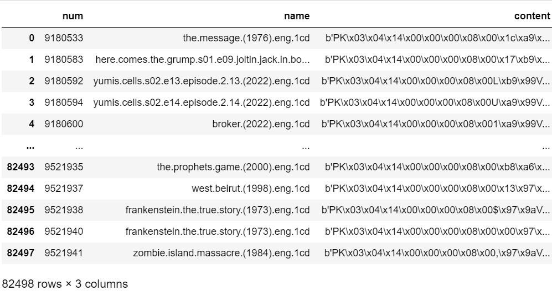
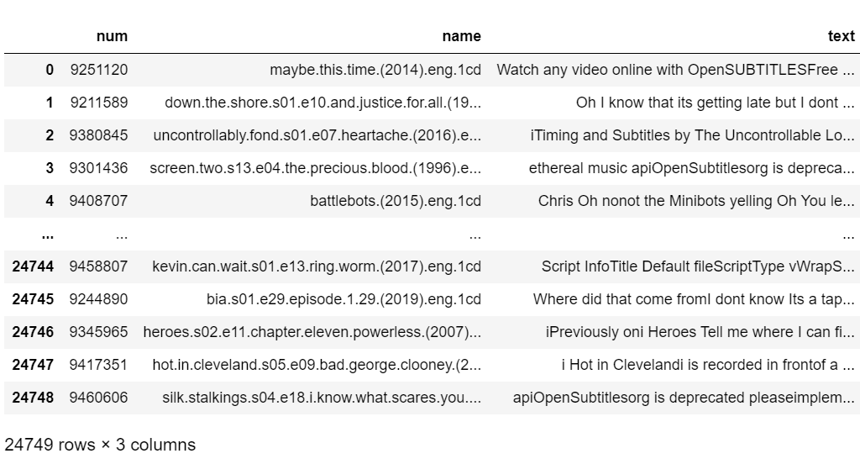
Data Extraction
Data Extraction : This involves retrieving the subtitle data from the provided source, such as a database file.
we used sqlite3 to connect to the database and extract the dataset
Decoding: Next, we load the dataset into a pandas dataframe for further analysis. The subtitle content is originally encoded with "latin-1" encoding, so we decode it to ensure compatibility and smooth processing.
Data Sampling : Due to computational constraints or other considerations, a portion of the data may be sampled for processing, typically a representative subset.
Originally, the dataset had 82,498 files but only 30% which is 24,749 files were used
The database consists of columns num, name and content
Data Sampling

Slide 8
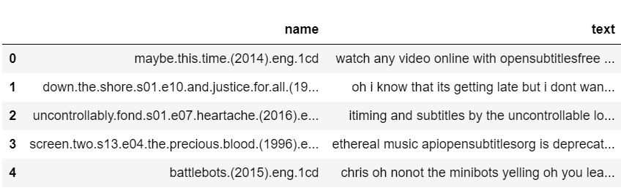
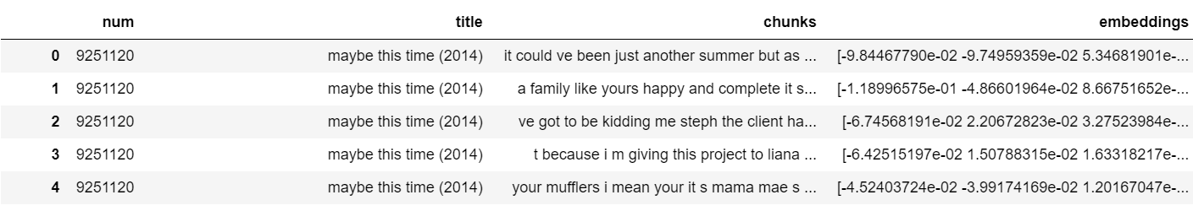
Data Preprocessing
Data Preprocessing : The subtitle data undergoes cleaning and formatting steps to ensure consistency and remove irrelevant information. This may include tasks such as removing timestamps, converting text to lowercase, and eliminating symbols or punctuation.
Chunking
Document Chunking : Large subtitle documents are divided into smaller, more manageable chunks to prevent information loss and improve processing efficiency. Overlapping windows may be used to ensure continuity of context across chunks.

Slide 9
Text Vectorization: Generating Embeddings
To help computers understand human language better, we use a technique called "text vectorization”. This process essentially translates words into numerical representations machines can understand and analyze. Different techniques offer varying levels of sophistication for this conversion:
      BOW/TF-IDF: This method creates a basic fingerprint by counting word occurrences. It excels at identifying exact matches, making it suitable for keyword-based search engines where finding specific terms is paramount.
      BERT Embeddings: This more advanced approach delves deeper, considering not just word frequency but also meaning and context. BERT excels in semantic search, where grasping the overall intent of a query is crucial. By employing BERT embeddings, we empower the search engine to understand the nuances of human language, leading to more relevant and insightful video content retrieval.
      The text data, now in a suitable format, is transformed into numerical representations known as embeddings. This step is crucial for enabling semantic analysis and similarity calculations.

Slide 10
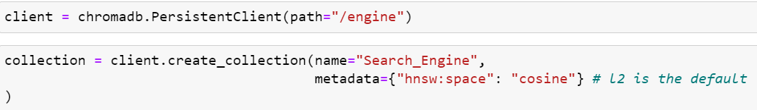
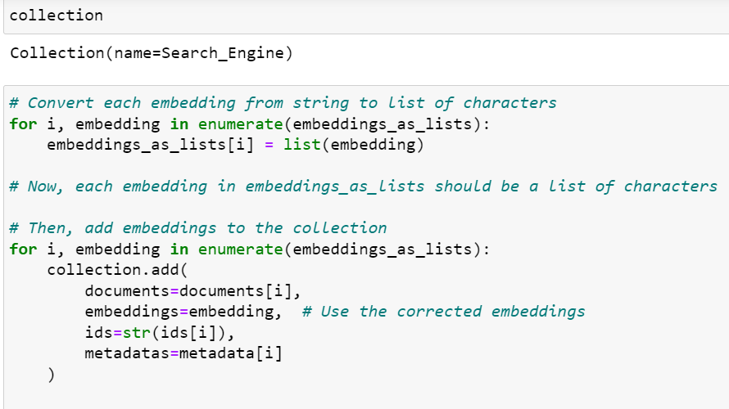
Storing Embeddings in ChromaDB
Storing Embeddings in ChromaDB : The generated embeddings are stored in a specialized database, such as ChromaDB, for efficient retrieval and management. This database may offer features like metadata enrichment and targeted retrieval based on user-defined criteria.

Slide 11
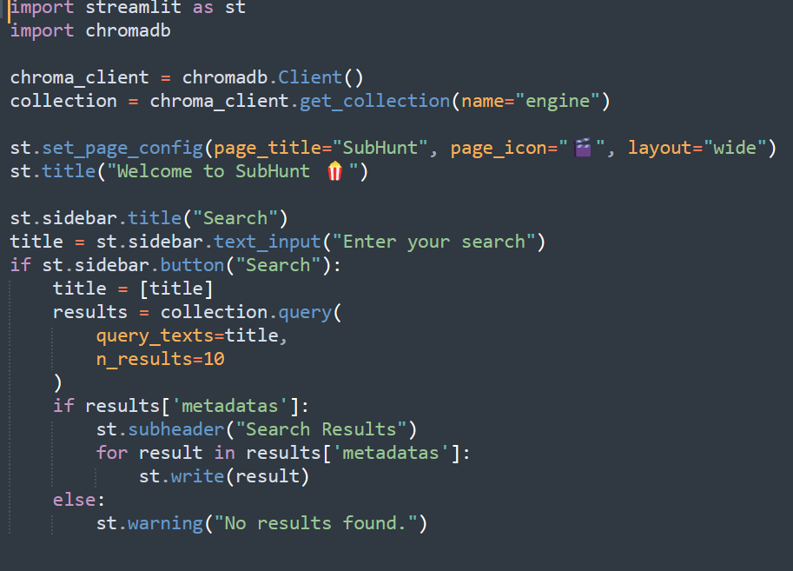
User Query and Semantic Search
User Query : Users input their search queries, which may be in the form of keywords or natural language sentences.
Semantic Search : The search engine processes the user query, potentially performing additional preprocessing to enhance understanding. Semantic analysis techniques are applied to capture the deeper meaning and context of the query.

Slide 12

Results
Using cosine distance or other similarity metrics, the search engine compares the embeddings of the user query with those of the stored documents. The most relevant documents are retrieved and presented to the user as search results.
Streamlit User Interface

Slide 13
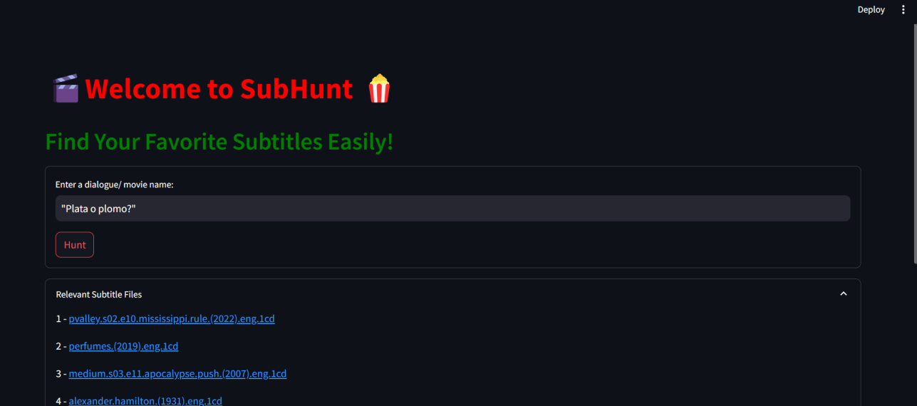

User Query and Search Engine Output
User Query
Search Engine Output

Slide 14

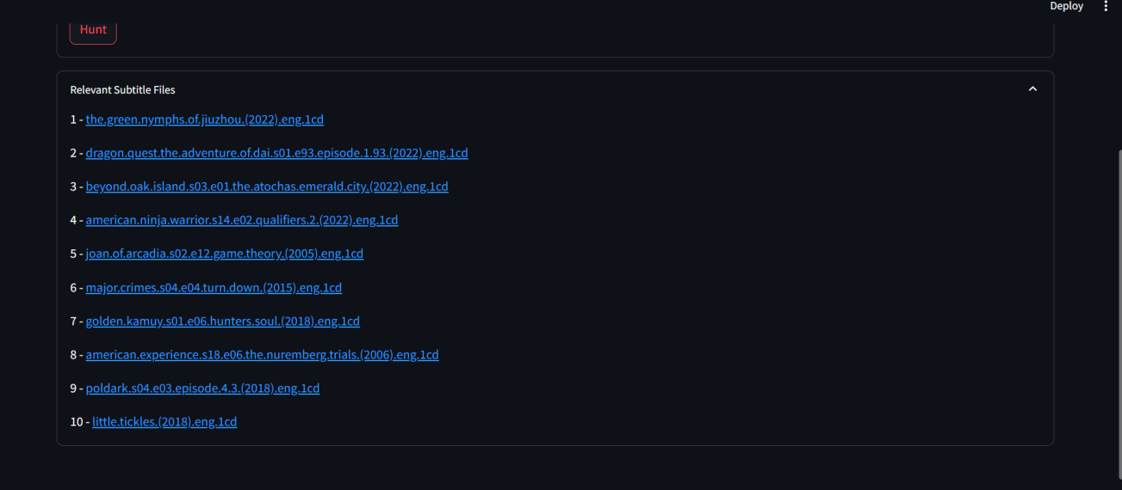
User Query and Search Engine Output

Slide 15
Conclusion
By leveraging advanced technologies like natural language processing and semantic search, we're not only enhancing video search accuracy but also revolutionizing accessibility. By indexing subtitles, we empower users with diverse needs, including those who are deaf or hard of hearing, to seamlessly navigate and extract valuable information from video content.
By harnessing semantic search capabilities, we're not only improving video search accuracy but also enabling users to discover relevant content more efficiently, saving time and effort in their browsing experience.
Additionally, by incorporating advanced recommendation systems, we're providing personalized suggestions based on users' preferences and viewing history, enhancing their overall video streaming experience.

Slide 16

THANK YOU

